Slide 1
Intro to the Wing
airfoils, lift/drag, and more!

Slide 2
Icebreaker - 5 mins
Dig around on our wing CAD model
come up with 1 thing that you want more information on OR a question on the design

Slide 3
Agenda
5 min — Ice-Breaker
10 min — parts of a wing + trivia
10 min — Definitions + trivia
5 min — Definition Activity
20 min — How does flight work?

Slide 4
Parts of the Wing

Slide 5
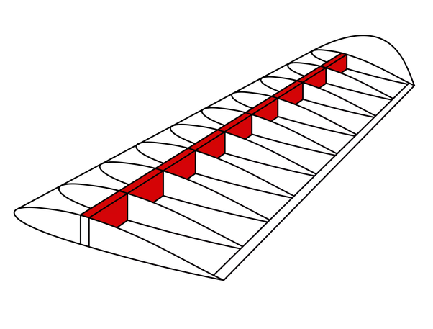
Spar
The spar is the main structural point of the wing, kind of like our spine
Runs vertically along the wing, from the fuselage to the wingtip
There is generally 1 spar per wing, but sometimes there are 2

Slide 6
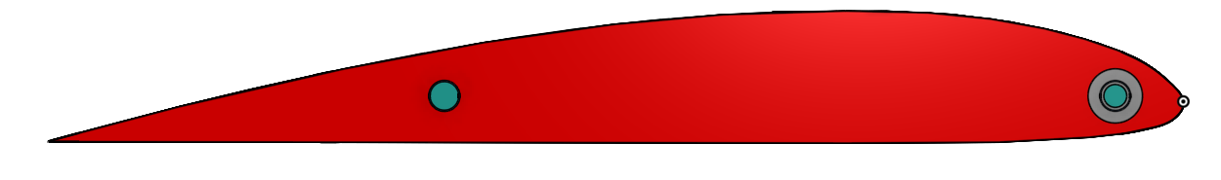
Ribs
cross pieces in the wing - run horizontally
Ribs are attached to the spar
Generate the lift + support the wing
Specific shape called “airfoil”

Slide 7
Aileron
A moving part the wings
Used by the pilot to control the roll of the plane
Increases angle of attack, so one side produces more lift than the other side, and the plane tilts. (Also increases drag)
DO NOT CONFUSE WITH FLAPS (Flaps use drag to slow plane to a stop while landing)

Slide 8
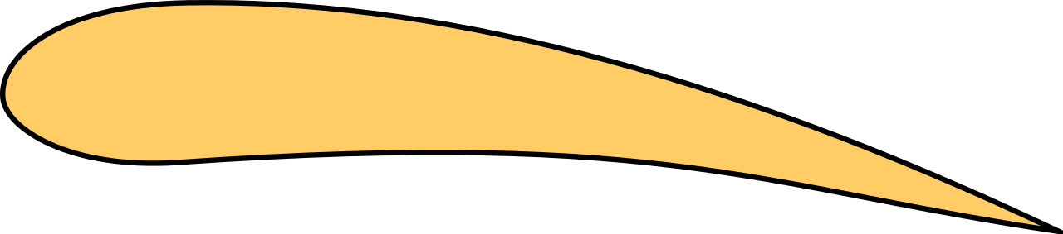
Airfoils
Lift
the side view of a wing
produces lift and drag
remember, lift is an upward force and drag slows the wing down, backwards force
There are lots of different airfoil shapes, each has different uses/benefits
Drag

Slide 9
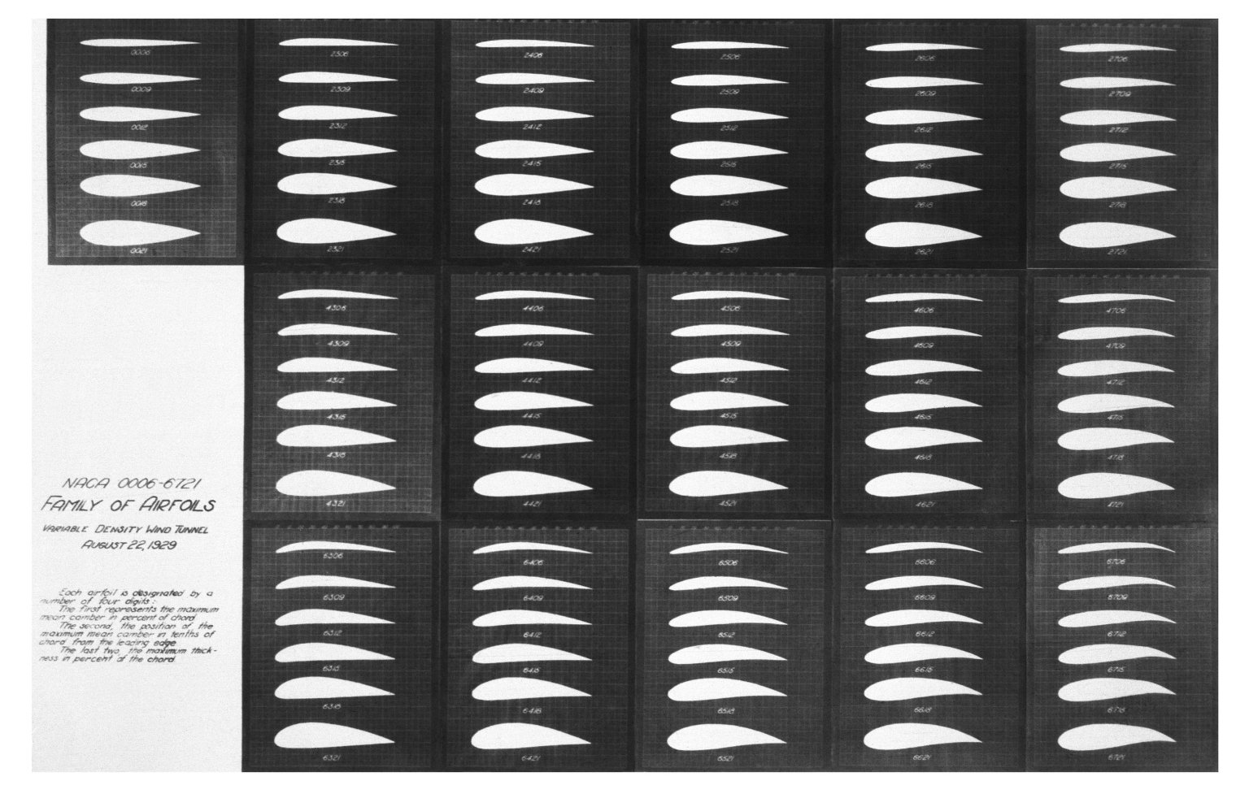

Slide 10
Trivia

Slide 11
What is the purpose of a spar?
Reduce drag
Give structure to the wing
Increase lift
Tilt the plane
Notes:
b

Slide 12
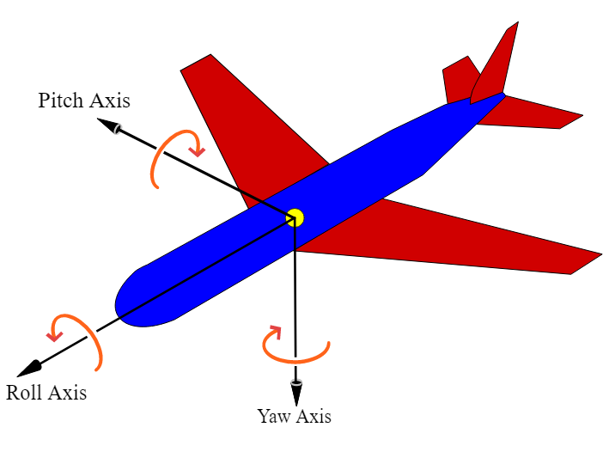
What does the aileron control?
Roll
Tilt/Pitch
Yaw
Notes:
a

Slide 13
What are ribs?
Lift generators
Roll controllers
Extruded airfoils
Both a & c
Notes:
d

Slide 14
Terms

Slide 15
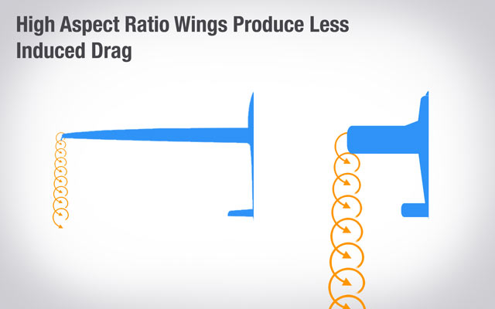
Aspect Ratio
How thin/fat a wing is (high aspect ratio = thin)
Induced Drag: air trying to curl around the tip of a wing
Most is generated this way
Higher, less drag
However, high aspect ratio wings are also harder to make safe

Slide 16
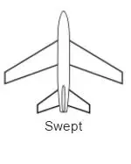
Sweep
Wings slanted forward or back
Swept wings are better for transonic aircraft, front swept is good for structural stability
Our wing is no sweep because it’s the simplest

Slide 17
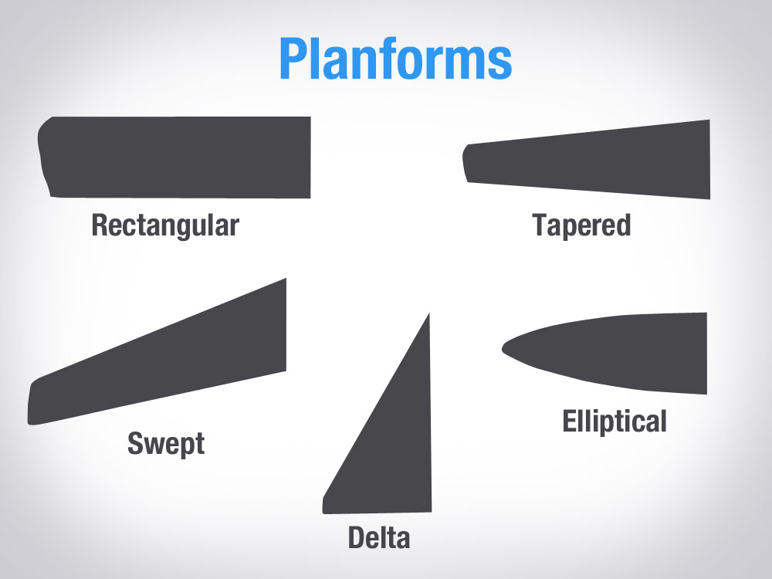
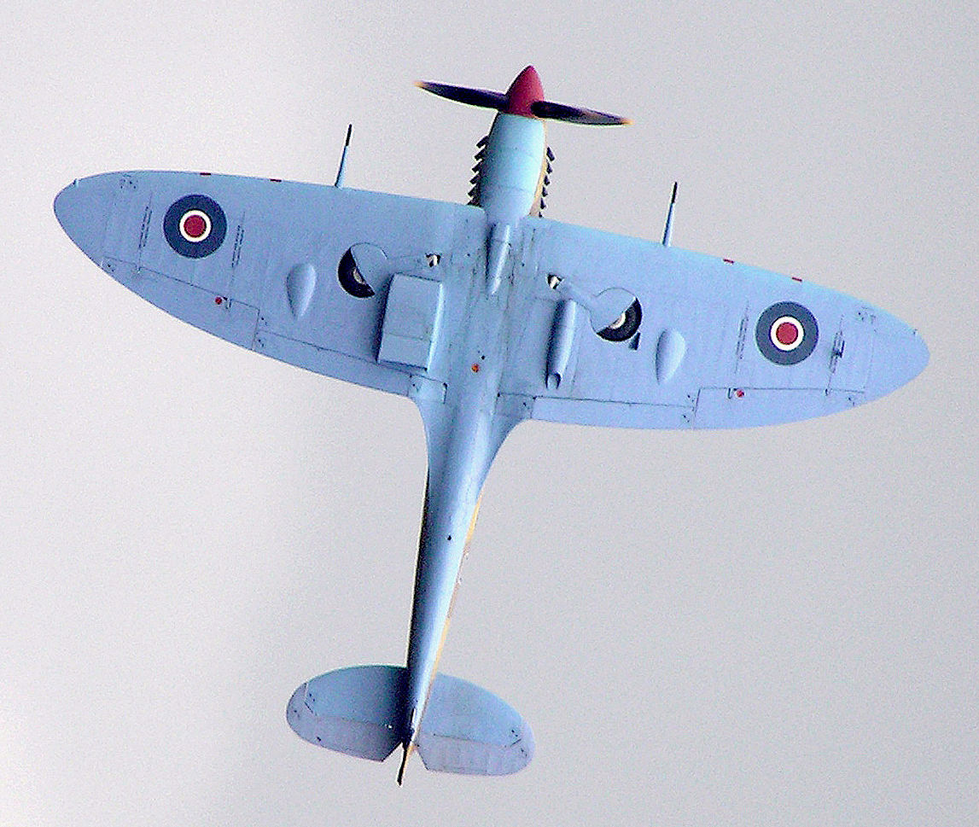
Wing Shape
Rectangular (our wing)
Simple, lots of induced drag
Trapezoidal (commercial aircraft)
Simplish, less induced drag
Elliptical (rounded tips)
Theoretically 0% induced drag, very hard to manufacture

Slide 18
Trivia

Slide 19
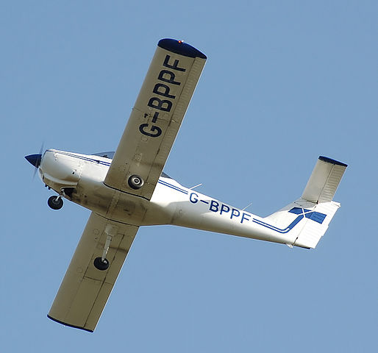
What is the shape of this wing?
Notes:
rectangular

Slide 20
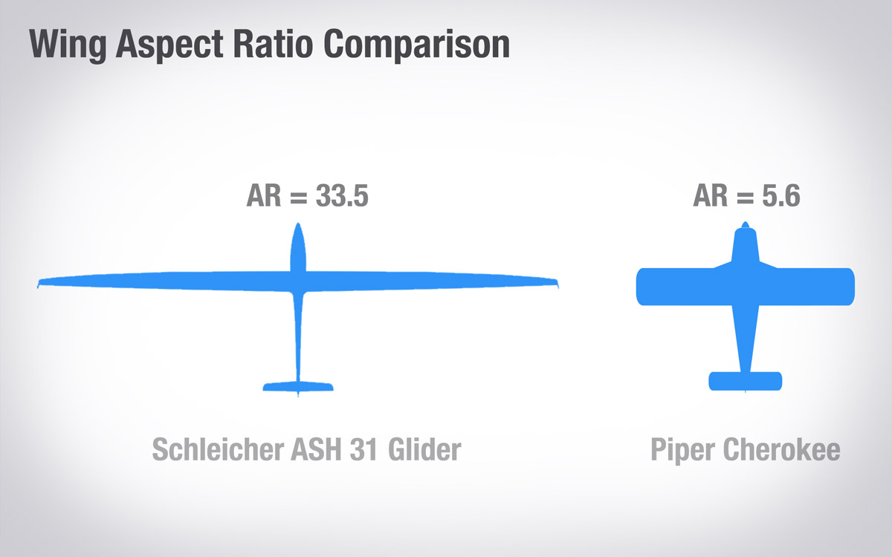
What are the benefits of high aspect ratios?
Higher lift
More structurally stable
Lower drag
Easier to control
Notes:
c

Slide 21
What type of sweep is this, and why do planes use it?

Slide 22
5 min activity
Spend 3 mins researching one of these and explain it to the rest of the group
Chord line
Camber line
Leading edge
Trailing edge
Wing span

Slide 23
What is Flight?

Slide 24
Activity!
Breakout rooms
Spend 3 mins researching the physics behind flight and come to a consensus
Room 1
words
Room 2
words
Room 3
words

Slide 25
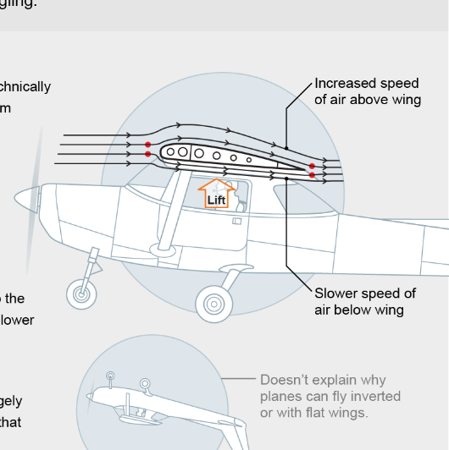
Bernoulli’s Principle
Bernoulli's Principle- the idea that a molecule is split into elements resulting in them wanting to get back together at the end is FALSE

Slide 26
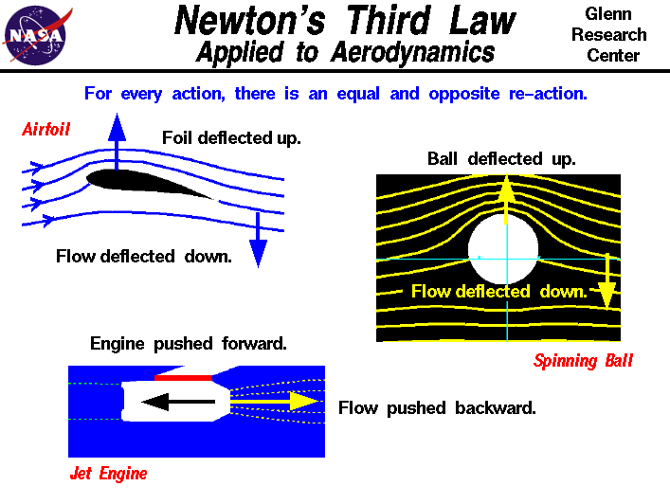
Newton + False lift theory
Newton’s 3rd law — air that goes under the wing is pushed down, which pushes the wing up, generating lift
Notes:
alex

Slide 27
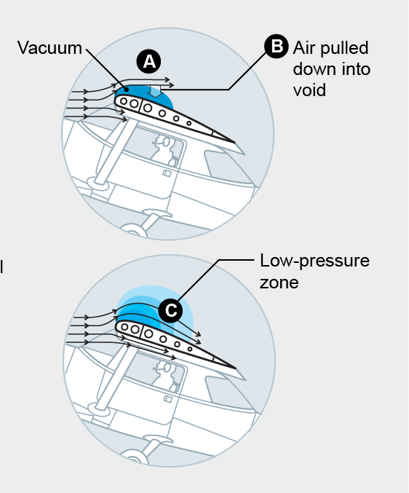
Possibility
The idea: in increase in velocity of a fluid results in a decrease of pressure
Possibility: Air above the wing A) momentarily flows backwards B) vacuum fills the void C) but not all of it - creating a low -pressure zone

Slide 28
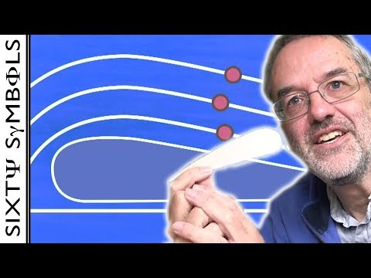
This is a wonderful video so i’ll find ~3 mins for the people to watch

Slide 29
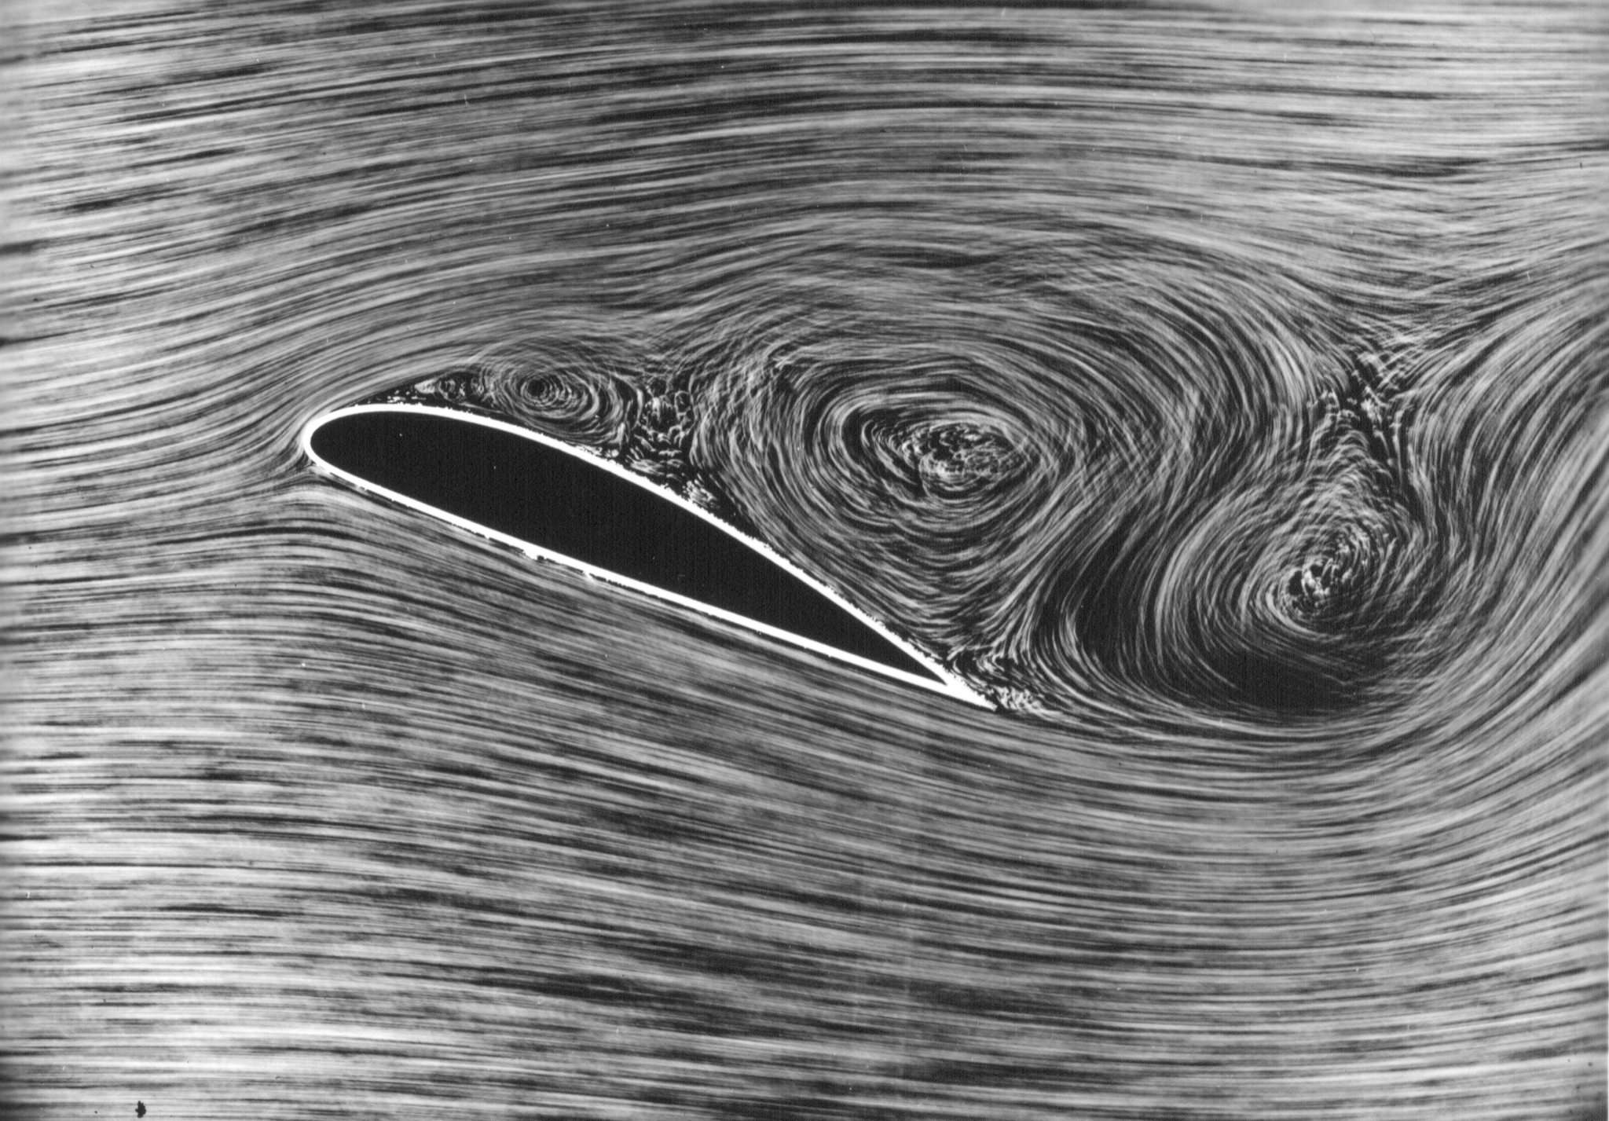
Synthesis:
no one knows,
but we have accurate equations!

